Slide 1
Gesture Controlled Toy Car
Onkar randive
Saurabh Deshpande
Devang motwani
Siva shashank

Slide 2
Motivation
Convenience
Fun moving a car with the flick of the wrist
Reduce complexity of using remote control

Slide 3
Block Diagram
Transmitter Module
Receiver Module
MSP430
H-bridge
Accelerometer
Motor 1
Motor 2

Slide 4
Overview
Accelerometer senses tilt and generates analog values.
Analog values are converted to digital values by MSP 430.
Digital values are transmitted to receiving module by transmitter.
Receiver passes the values to motor driver IC.
Motor driver IC drives the motor.

Slide 5
Interfacing of MSP430 with the Accelerometer
MSP430
Accelerometer
Input
X_AXIS
P8.6
Y_AXIS
P8.5
Z_AXIS
P8.4

Slide 6
Internal working of ADC module in MSP430
MSP430
P8.6
ADC module
P2.0
P8.5
P9.3
P8.4
P4.2
P4.3
Comparison of Digital values

Slide 7
Interfacing of MSP430 with Transmitter
MSP430
Transmitter module
Output
P2.0
13
P9.3
12
Encoder
P4.2
11
P4.3
10

Slide 8
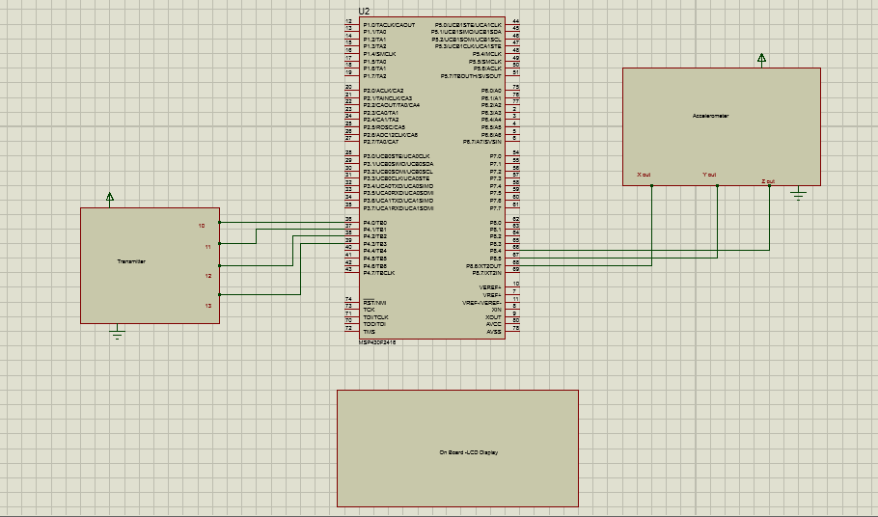
Schematic

Slide 9
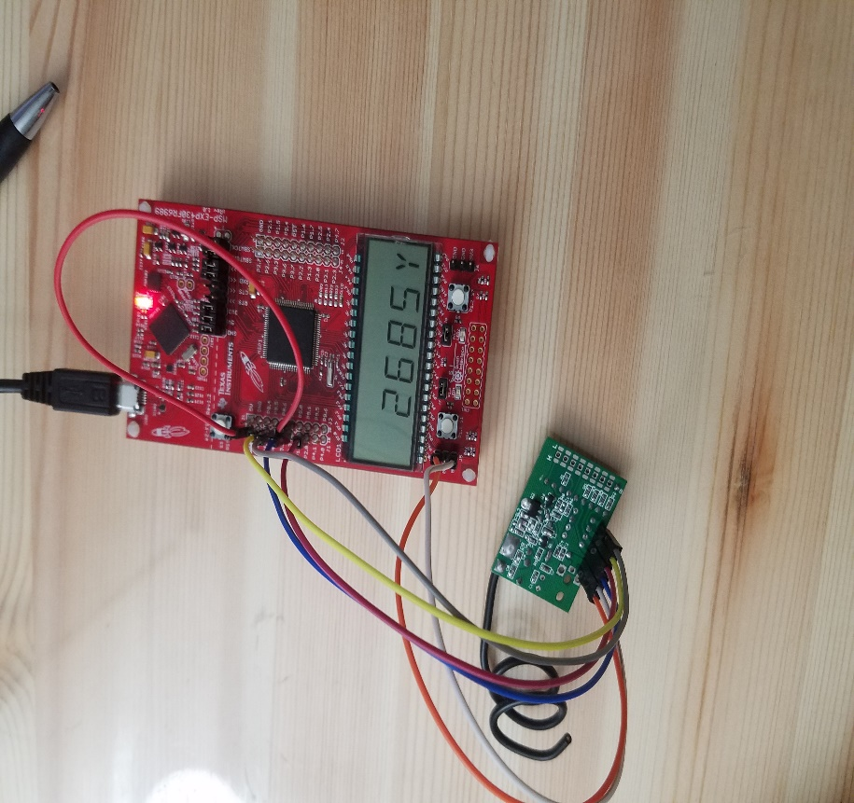
Transmission module

Slide 10
Interfacing of Receiver module with H-bridge
Chasis
Receiver module
H-bridge
D0
IN1
Decoder
D1
IN2
D2
IN3
Motor 1
D3
IN4
OUT1
+5V
+5V
OUT2
GND
GND
External battery
Motor 2
+9V
+9V
OUT3
GND
GND
OUT4

Slide 11
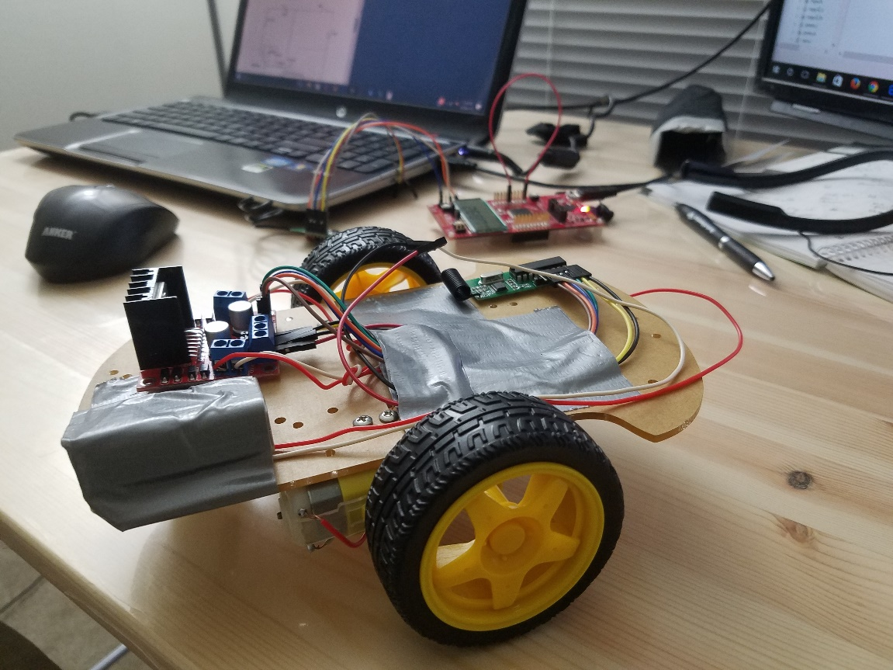
Receiving module

Slide 12
Software description
Code composer studio is used to write and dump the code onto the MSP430
Proteus – Schematic Design

Slide 13
Results
The analog values of the accelerometer were successfully acquired and converted to digital values using MSP 430.
Threshold values were set accordingly for respective directions.
Successful wireless communication was established and 4 bit data was transmitted.
The receiving module received transmitted data successfully which is used to drive the vehicle.

Slide 14
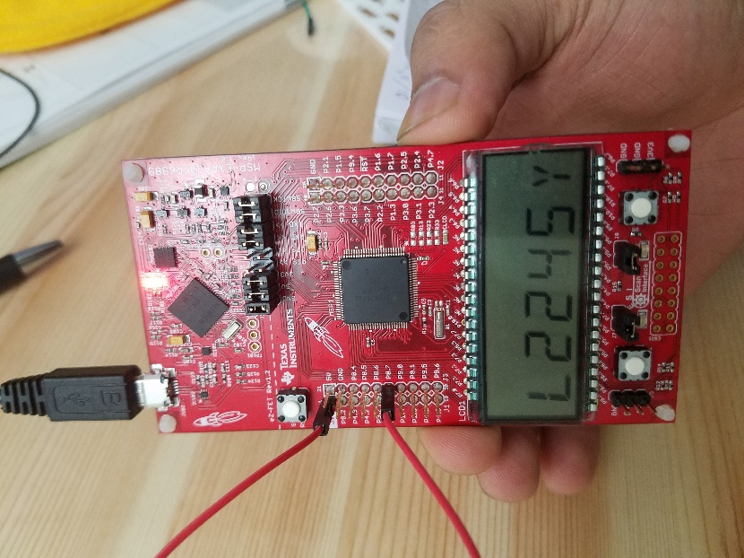
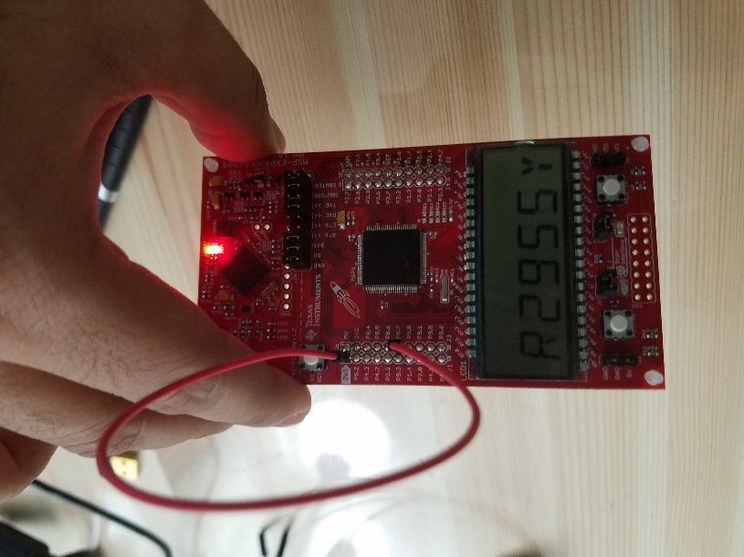
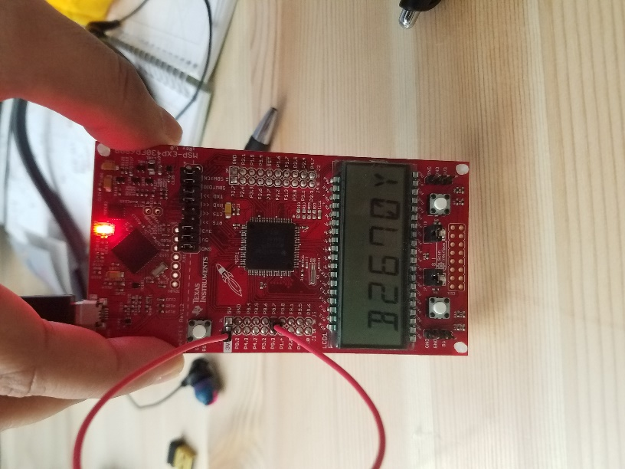
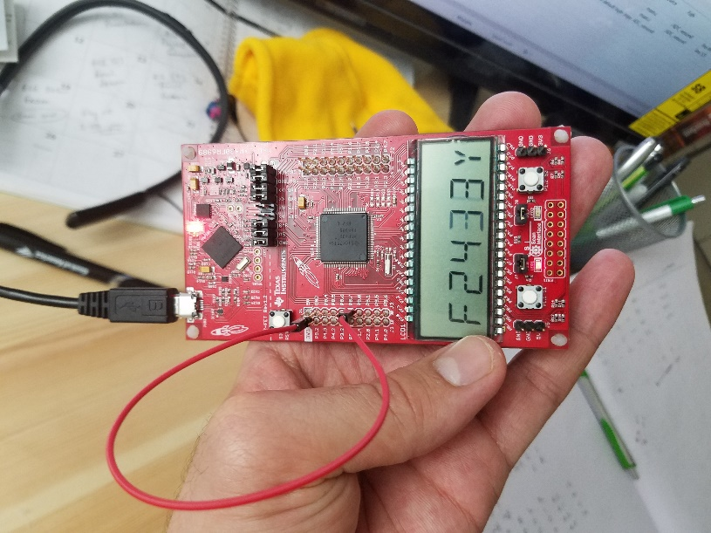
Results

Slide 15
Achievements
We finished the whole project without using a second microcontroller on the receiving module.
The proposed results were achieved.
Using another wireless transmission medium was a backup plan in case the RF transmission failed. Fortunately, data was successfully transferred using RF transmission and there was no need to use the backup plan.

Slide 16
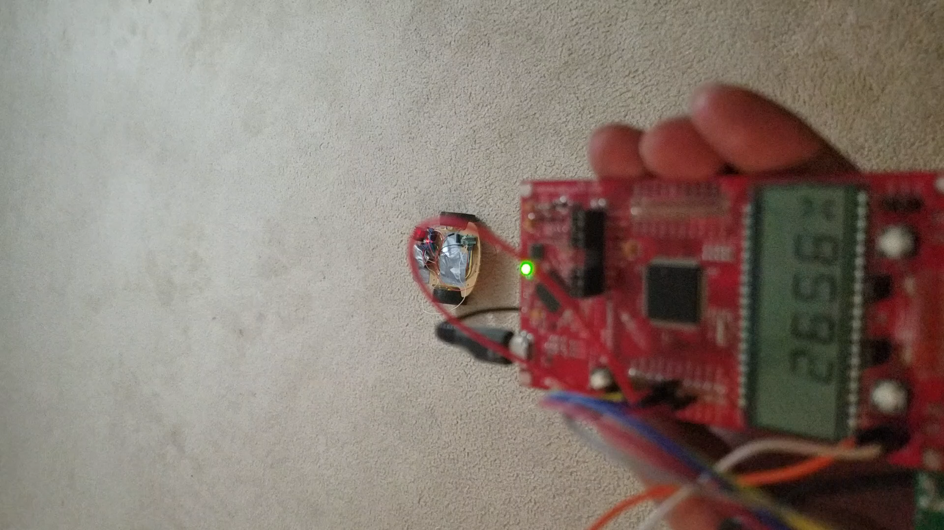
Demonstration

Slide 17
Thank you!

